Slide 1
LSTM vs BiLSTM for Human Activity Recognition

Slide 2
Working of LSTM
Input Sequence
Previous states + Current input
Forget gate
Input gate
Candidate memory
Dense Layer
Hidden State
Output gate
Cell state
Softmax classification
Prediction

Slide 3
Working of BiLSTM
Input Sequence
Forward LSTM Processing
→ model learns patterns using past to future motion information
Backward LSTM Processing
→ Model learns patterns using future to past motion information
Feature Combination
→ Merging outputs of both processing
Dense Layer
Softmax classification
Prediction

Slide 4
LSTM vs BiLSTM
Feature | LSTM | BiLSTM
Direction | Forward only | Forward + Backward
Context Learning | Limited | Rich
Complexity | Lower | Higher
Parameters | Fewer | More
Training Time | Faster | Slower
Performance | Good | Better

Slide 5
Dataset and Pipelining
Dataset is organized person-wise where each person’s activities are grouped into CSV files based on activity.
Activities include: Walking, Jumping, Running, Bending, standing, sitting, squat.
Pipelining:
Data Preprocessing
Sliding window segmentation
Feature Normalization
Dataset split into training and testing
Model Training
Activity Prediction
Performance Evaluation

Slide 6
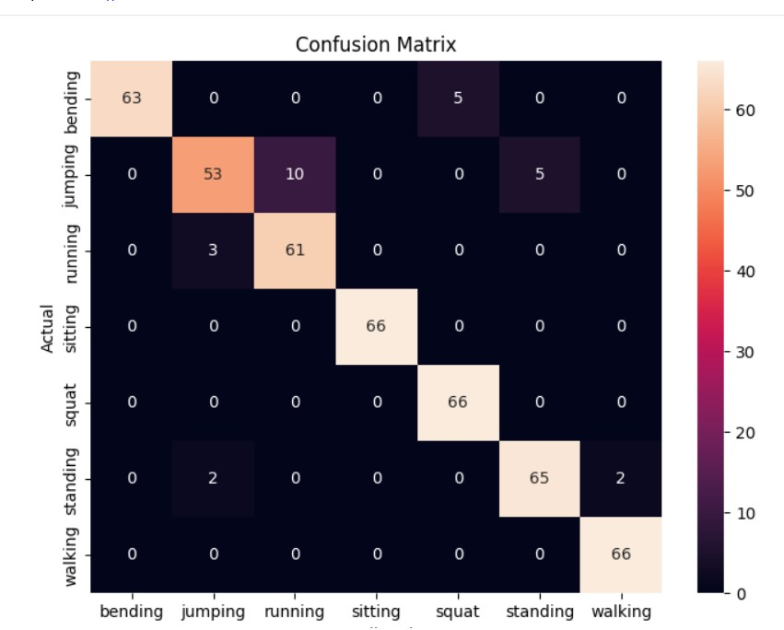
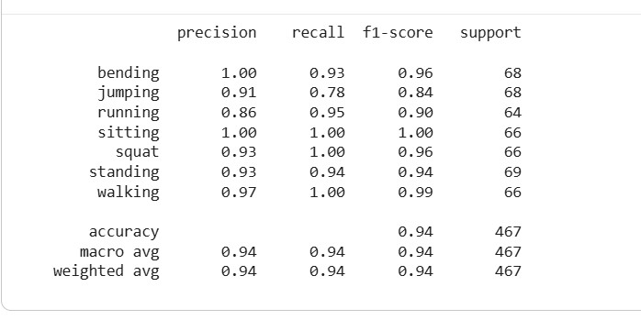
Performance metrics and Confusion Matrix [LSTM]

Slide 7
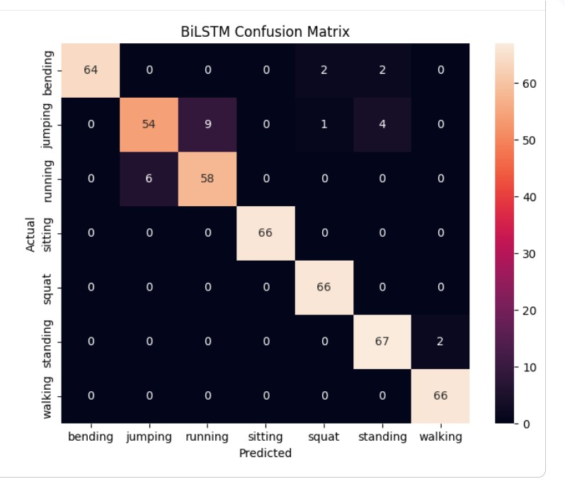
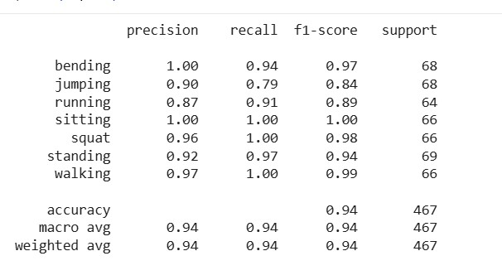
Performance metrics and Confusion Matrix [BiLSTM]

Slide 8
Observations
LSTM:
The LSTM model achieved approximately 94% overall classification accuracy.
Sitting, squat, and walking activities were classified with very high accuracy.
Some confusion was observed between jumping and running due to similar motion patterns.
The model successfully learned temporal dependencies from sequential data using forward sequence learning.
BiLSTM:
BiLSTM achieved high accuracy of 94%.
Most activities were classified correctly with very few errors.
Sitting, squat, and walking showed excellent prediction performance.
Bidirectional learning improved temporal feature understanding.
BiLSTM reduced misclassification compared to LSTM.

Slide 9
Conclusion
Both LSTM and BiLSTM models performed effectively for Human Activity Recognition.
Sliding window preprocessing improved sequential feature learning.
BiLSTM achieved better contextual understanding using bidirectional sequence processing.
Confusion matrices and performance metrics showed reduced misclassification in BiLSTM.
Therefore, BiLSTM is slightly better.

Slide 10
Thank you

